Slide 1
SonarQube
Crystal Tenn
Crystal.Tenn@microsoft.com

Slide 2

SonarQube
SonarSource delivers what is probably the best static code analyzer you can find on the market for C#. Based on Microsoft Roslyn compiler front-end, it uses the most advanced techniques (pattern matching, dataflow analysis) to analyze code and find code smells, bugs and security vulnerabilities. As for any product we develop at SonarSource, it was built on the following principles: depth, accuracy and speed.
SonarC# has a great coverage of well-established quality standards. The SonarC# capability is available in Visual Studio for developers (SonarLint) as well as throughout the development chain for automated code review with on-premise SonarQube or on-line SonarCloud.

Slide 3
SonarQube
Easy analysis of any existing Visual Studio Solution or MSBuild project
Native integration with any existing build in TFS or VSTS
Code coverage by tests: SonarC# supports the import of Microsoft Visual Studio, dotCover, OpenCover, and NCover 3 test coverage reports.

Slide 4
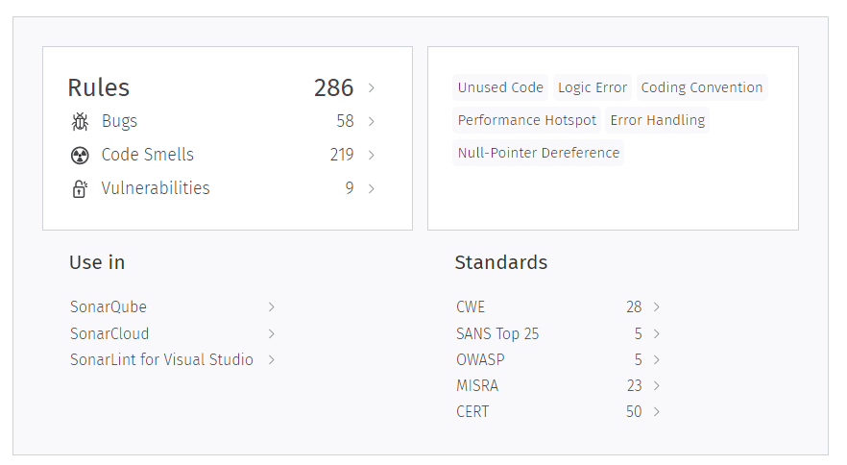
Main Dashboard

Slide 5
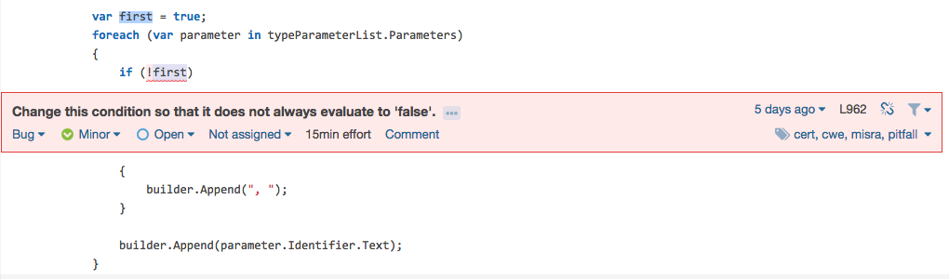
Sample of Code Cleanup Suggestions

Slide 6
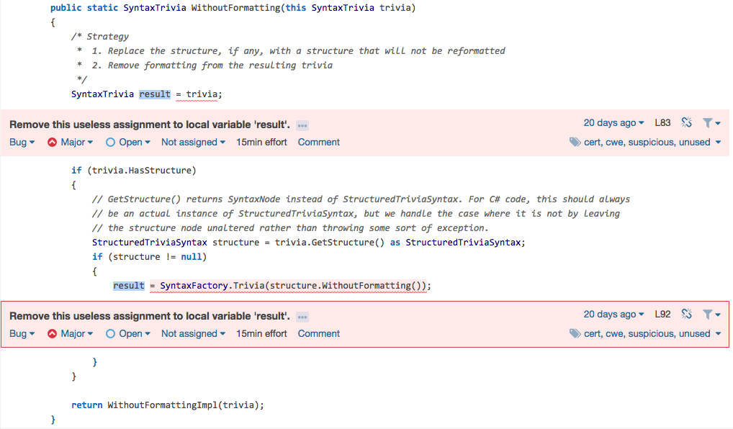
Sample of Code Cleanup Suggestions

Slide 7
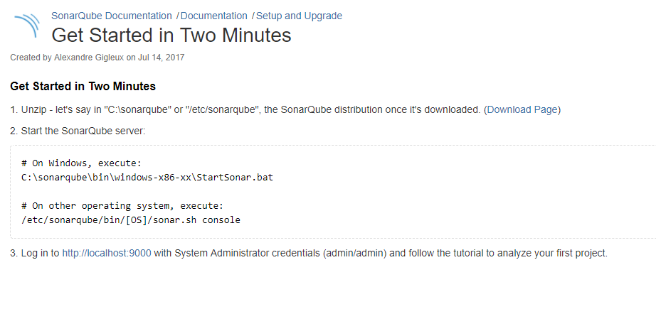
https://docs.sonarqube.org/display/SONAR/Get+Started+in+Two+Minutes

Slide 8
Full SonarQube Setup Documentation
The only prerequisite for running SonarQube is to have Java (Oracle JRE 8 onwards or OpenJDK 8 onwards) installed on your machine.
The SonarQube server requires at least 2GB of RAM to run efficiently and 1GB of free RAM for the OS.
https://docs.sonarqube.org/pages/viewpage.action?pageId=1441900

Slide 9
Thank you!

